Slide 1
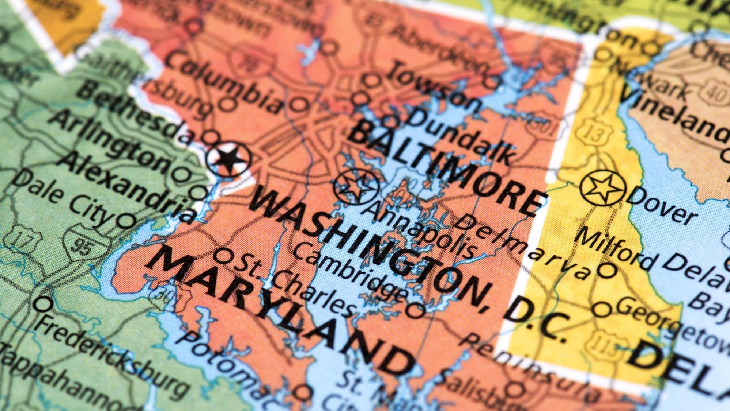
Maryland County
Open Data
INFM 600 Final Project
Notes:
Maryland’s Open Data Portal is a repository containing wide-ranging data from acres of cover crop to youth homicide. Data are conveniently grouped by county, city, or other jurisdiction. We are specifically interested in population and education data, because anecdotally, people talk about how different Montgomery county is compared to other areas in the state. We want to see if this is really the case. How much do Maryland counties vary in terms of demographics, resources, and other attributes? Is Montgomery county a hot spot of income and resources? In this project, we will specifically look for themes related to education that could be used by State and County governments to inform where resources and services could have the biggest impact, by comparing and contrasting the highest and lowest performing counties.
Image Attribution: iStock Retrieved from https://www.washingtonexaminer.com/opinion/op-eds/douglass-county-heres-how-dc-can-gain-congressional-representation-through-retrocession-to-maryland

Slide 2
INTRODUCTION
Prescriptive
High/Low Performing Counties
Relationship with Socioeconomic Demographics
Compare with Other States
Factors that impact key metrics
What questions can this data set help answer?
Predictive
Predict #s graduates 10 years from now
Risks, Assumptions & Limitations
Data collection and processing is unknown
Representativeness of data to population is unknown
Notes:
Questions this data set might help answer
Prescriptive
What, if any, are the differences between the highest and lowest performing counties in terms of High School Attainment? Can we identify any trends/correlations?
Is there a relationship between the cost of living, average income, poverty rate, and/or the amount of money the county spends on education per student?
How does the state of Maryland compare to the rest of the country in terms of educational outcomes, education costs, etc.?
Predictive
Does an increase in public school expenditures correlate to an increase in graduation rates, decrease in unemployment and/or a higher average income? Is this predictable - as in increasing expenditures by x% would raise attainment y%?
Based on projected high school enrollment rates how many more graduates will we see 10 years from now?
Based on known graduation rates for 2010-2017, can we predict graduation rates by race 10 years from now?
Risks, Assumptions and Limitations
For these data sets, we are assuming that the curators of the data (various Maryland Departments) did appropriate data cleansing and normalization of the raw data. Study designs were not specified; therefore we have no knowledge of how the data was collected and processed. This is a risk area as the data could be challenged for validity. For instance, we do not know if data was collected through surveys and/or if the responses are representative of the population. We also do not know how or if the data authors assured that traditionally underrepresented populations were included.

Slide 3

Hypotheses
...counties with better high school attainment also have a lower poverty rate, higher income, and/or more residents with college degrees.
...counties that spend more money on education will also report better educational outcomes.
...counties with a higher median income and/or quality of life score will spend more money on education.
...Montgomery county will be in the top 10% in terms of income, educational outcomes and
...Maryland will be in the top 25% of the country in terms of higher education degrees attained.
...regardless of educational spending, Black and Hispanic students will have a lower rate of graduation than their White or Asian counterparts.
Notes:
Hypotheses
We hypothesize that...
...counties with better high school attainment also have a lower poverty rate, higher income, and/or more residents with college degrees.
...counties that spend more money on education will also report better educational outcomes.
...counties with a higher median income and/or quality of life score will spend more money on education.
...Montgomery county will be in the top 10% in terms of income, educational outcomes and
...Maryland will be in the top 25% of the country in terms of higher education degrees attained.
...regardless of educational spending, black and Hispanic students will have a lower rate of graduation than their white or Asian counterparts.

Slide 4
INTRODUCTION
Who are our Stakeholders?
Residents
Educational Outcome
Living Conditions
Resources
Governments
State/County
Strategic Planning
Issue Resolution
Resources
NGOs
Education Equality
Resources
Notes:
Who are our stakeholders?
The residents who live in each individual county and are interested to know how their respective county have performed in terms of educational outcome, living conditions;
Migrants who intend to move to Maryland will be eager to find the right place within the state so that the local resources meet their needs;
The state and county governments will need this data and analysis to make future strategies and plans to address issues found and improve people’s lives;
NGOs and advocates who believe in education equality will fight against the unbalanced allocation of educational resources within the state.
What are our stakeholder’s main challenges related to our topic/data?
The information in these datasets are dispersed. It is hard to extract meaningful information from the decentralized spreadsheets;
Deeper analysis requires strong understanding of and experience in the domain.
Why do they care about these things?
Migrants want to find the right place to live.
Government officials need statistics and analysis to make informed decisions about strategies to improve the local economy and living conditions.
Nonprofit organizations are passionate about fighting against inequity and imbalance among places.
How will our analysis help them? How will our analysis address these challenges?
Our centralized, post-processing dataset will give our stakeholders an all-in-one place to search, extract, compare all the information they need.
Our analysis will help them to make informed decisions and serve as supporting evidence and documents when they need to develop strategic planning.

Slide 5
Data Cleaning Framework
PREPROCESSING
Develop Shared Understanding
Identify Potential Inconsistencies
Consolidate & Reduce
5
Notes:
As part of our initial planning process we broke down our project into several smaller tasks and assigned each person to one of three roles: Lead, Assistant and Quality Control. Before starting any data cleansing or statistical analysis, we wanted to ensure our team had a shared understanding of the scope of the project, the desired goals, project milestones, and most importantly standard definitions of data elements. To accomplish this, one of the first things we accomplished was creating a data dictionary.
Data dictionary
This contained metadata for every field in our data set, guidance on interpretation, preliminary calculations we could run, and potential red flags. Having a data dictionary made communicating with the team very easy. Since most of the team was not directly involved in the data preprocessing, being able to communicate with the team through language and verbiage in the data dictionary about progress and questions, gave everyone a connection point that we could gather around for communication purposes.
A primary factor that guided the decisions that we made in preprocessing was whether the data that was included in the final datasets would inform the questions that we had proposed to answer. If the data did not relate in any way, then the data would be filtered out so that we could focus our efforts. The data dictionary made it easy to identify what data would be included in the final data set and what could be disregarded.
Overall, this was a powerful tool not only for planning purposes, but for keeping track of the final data set, and helping to mitigate any roadblocks and confusion.

Slide 6
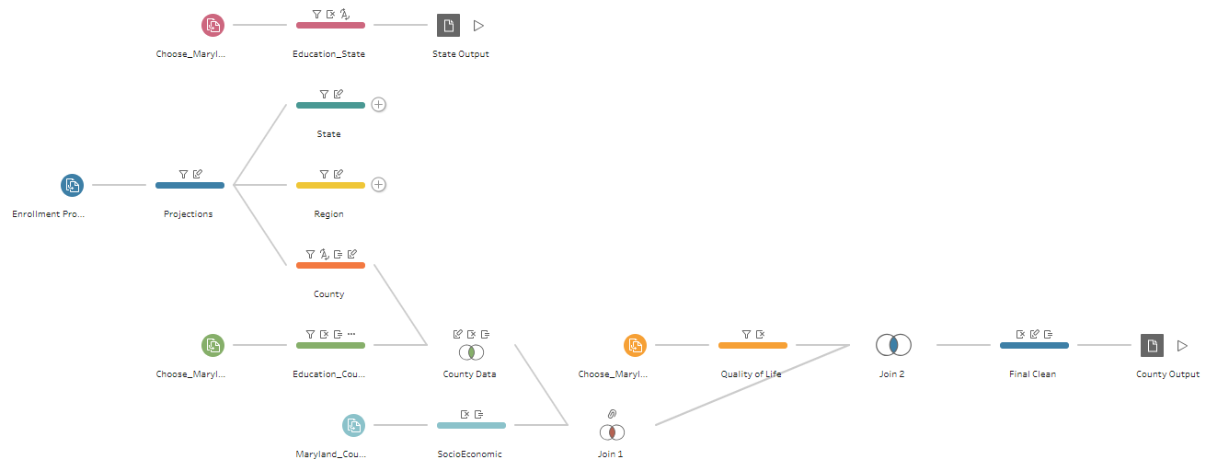
PREPROCESSING
Tableau Prep
Notes:
What were some of the errors and inconsistencies in the data?
The data itself was not structured in a way that was designed to be machine readable. Instead, the data was created to be human readable. Some of the individual datasets were not normalized, so it made retrieving via a script too difficult. Instead, they had to be manually dealt with. Thankfully, Tableau Prep made this process simple.
Once the irrelevant fields were removed from the datasets, we realized that there wasn't that much messy data that we had to deal with later. The data itself was easy to manipulate and work with. This makes sense since the data came from the state of Maryland, where one could expect it to be accurate and well structured.
Describe how the data are preprocessed for analysis.
In total there were 5 different data files that had to be combined to make 2 cohesive outputs. By joining related datasets, we hoped to discover interesting relationships among different variables. In addition, we focused on education and how education affects the socioeconomic characteristics among various counties.
The sets included projected high school enrollment rates, high school graduation rates, demographics and socioeconomic data broken down by Maryland Counties.
The two outputs were:
State Data
Data related to High school and higher education attainment by state.
County Data
Consolidated data set containing information on demographics, socioeconomic data and education statistics by Maryland county.
What will you do differently next time?
It may or may not be better to have specific datasets that relate directly to the very specific questions that we are seeking to answer. In our instance, we decided to create one large comprehensive dataset that would include all the material needed to answer all our questions. Next time, we may experiment with using datasets specifically designed to be able to answer each one of the questions proposed. The downside to this idea, is that it may inhibit a deep dive or exploration of different items if those items are not included in the “optimized” data file.

Slide 7
Statistical Framework
STATISTICAL ANALYSIS
Cross-Check
Iterate
Identify Correlations
7
Notes:
Statistical framework: Once we completed a draft of our preprocessed data set, our next step was to review our project description, data dictionary and planning documents to see if anything has changed with the newfound knowledge gained about our data set during cleanup. From that point onward, the project became iterative, cycling back and forth between processing and analysis as we identified flaws in our plan and data points we were missing.
For example, we noticed a key limitation of the High School Graduation Rate by Race data; in that we were missing a necessary variable to pull out the percentage of graduates in each racial category. As such, we removed the data from our preprocessing flow. We also created additional calculated fields directly in Tableau Desktop to ensure we were comparing equivocal data points (such as percentages vs raw numbers).
Many of the questions that we sought to answer involved checking to see if relationships exist among variables, and if so, how strong are they. As such, our analysis began with linear regressions.

Slide 8
STATS
Data Focus
High School Attainment
High/Low Performing Counties
Relationship with Socioeconomic Demographics
Compare with Other States
Public School Spending & Student-to-Teacher Ratio
Influence on HS Attainment
Relationship with Socioeconomic Demographics
Factors that influence spending
Quality of Life
High/Low Performing Counties
Influence on HS Attainment
Relationship with Socioeconomic Demographics
Factors that Impact Quality of Life
Notes:
On the next several slides we will show you our Tableau worksheets. We can’t show on the PowerPoint, but additional details can be seen when you hover over individual elements. You can see the p-value and r squared value used for our analysis when you hover over the trend line.

Slide 9
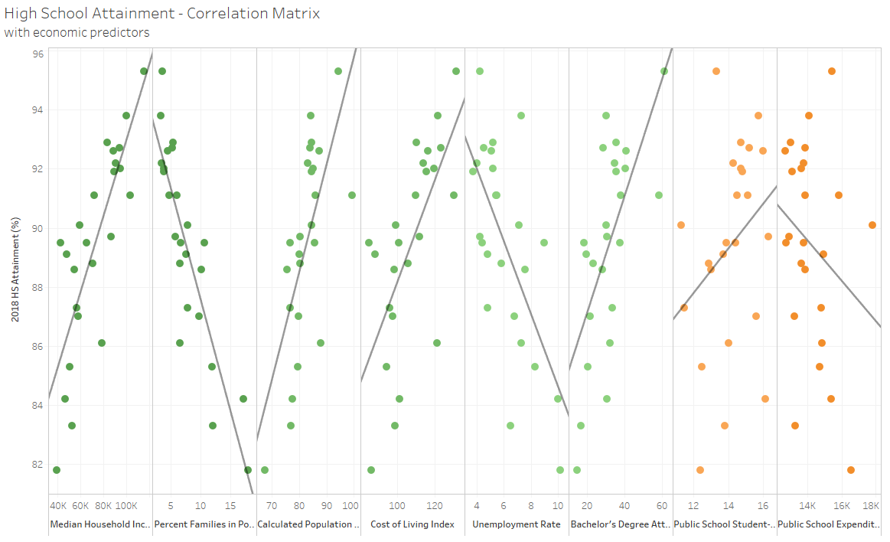
Notes:
The High School Attainment Correlation Matrix demonstrates the relationship between different variables as they relate to high school attainment. All our charts are arranged in order of p-value from lowest to highest from left to right. As such, items of high to moderate significance will be found on the left.
Several economic factors are correlated with higher high school graduation rates. These include Median Household Income, Percentage of Population in Poverty, Unemployment Rates, and Cost of living. Income and Cost of Living have a positive correlation – as those numbers increase, so does the percentage of graduates. The inverse is true for Poverty and Unemployment rates – as those numbers decrease, the percentage of graduates increases. Further there is a moderate positive correlation related to the education level of the population – the higher educated, the higher proportion of students who graduate high school.
There is some difference among counties with Somerset County having the lowest graduation rate at 81.8% and Howard County having the highest at 95.3%. Prince George’s is an outlier, having both a high cost of living index but lower high school attainment percentage.

Slide 10
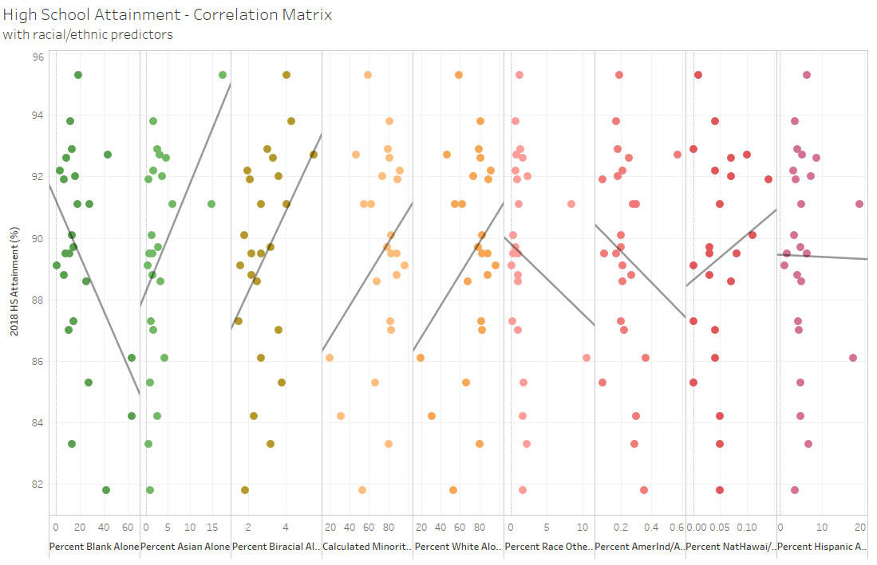
Notes:
Race did not have a strong correlation with HS graduation rates, except for the percentage of the population that identified as either Asian Only or Black only. Both these groups see a moderate positive correlation with increased HS graduation rates. The r-squared score for this was low, indicating that this is an area that could use further research to attain a more accurate model.

Slide 11
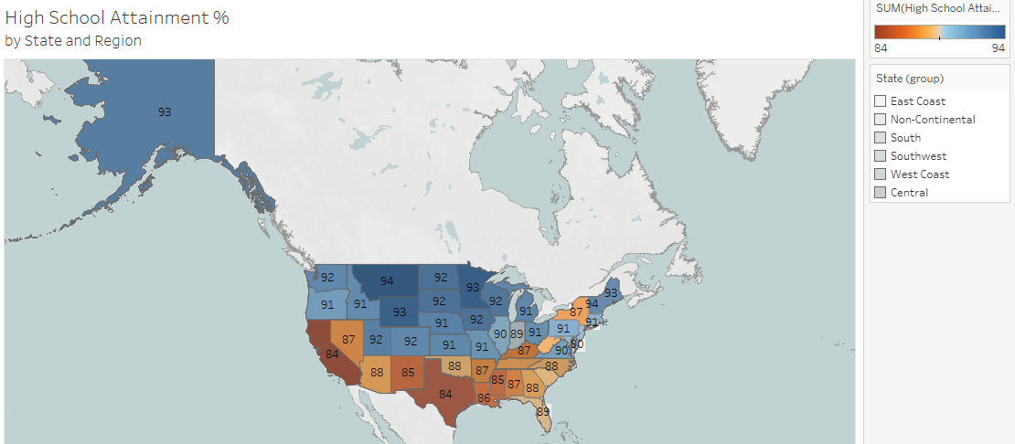
Notes:
Here we have an overarching look to see how Maryland compares to the rest of the United States. As of 2018, Maryland’s statewide average graduation rate is 91%, which as you can see is on par with most of the country.

Slide 12
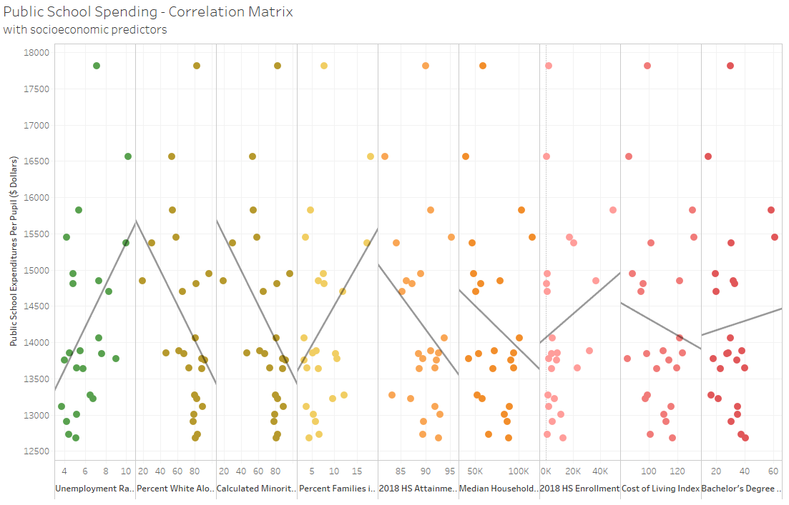
Notes:
It is difficult to tell what is driving these numbers. Most data points have no correlation with spending. A modest correlation was found with unemployment rate and the percentage of the population that identified as White Alone or our calculated percentage of those who did not. Unemployment rates have a positive correlation with public school spending, indicating that more funds are allocated in areas of need. There are clearly other factors at play, perhaps tax rates, gambling income, or federal allocations, and this is an area for further research.

Slide 13
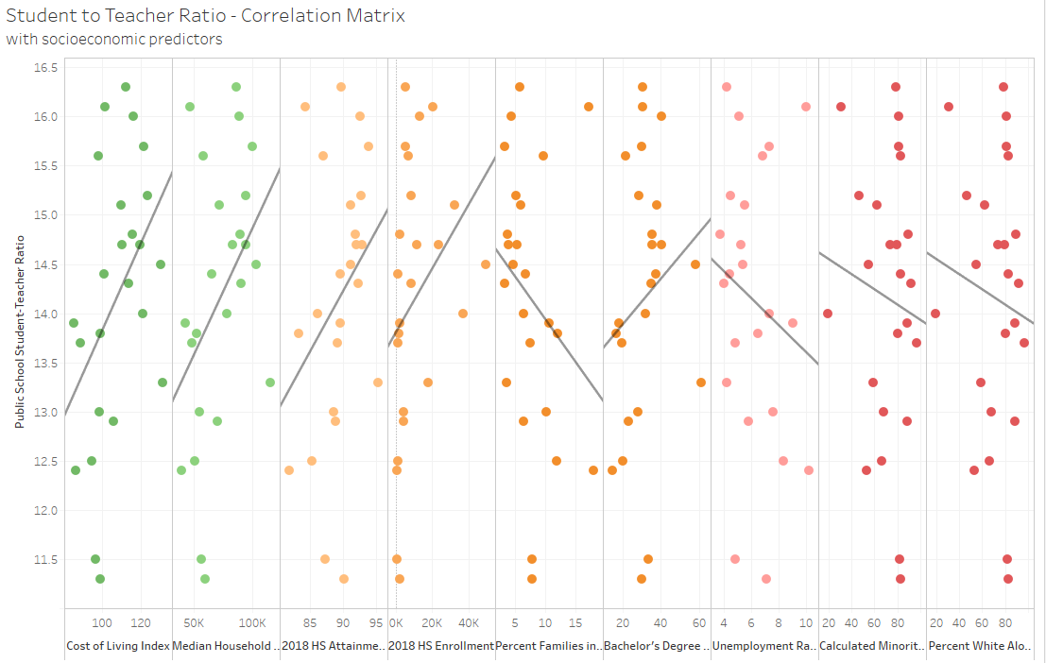
Notes:
Class size appears to be driven predominantly by economic factors. The only data points that showed a correlation to class size were the cost of living index and median household income. As those rates increase, so does the Student-to-teacher ratio. This could indicate that students in wealthier counties have perhaps more enrichment/services available to them, leading to fewer behavioral problems, thus requiring less teachers to manage. This is purely speculation and is an area for further research.

Slide 14
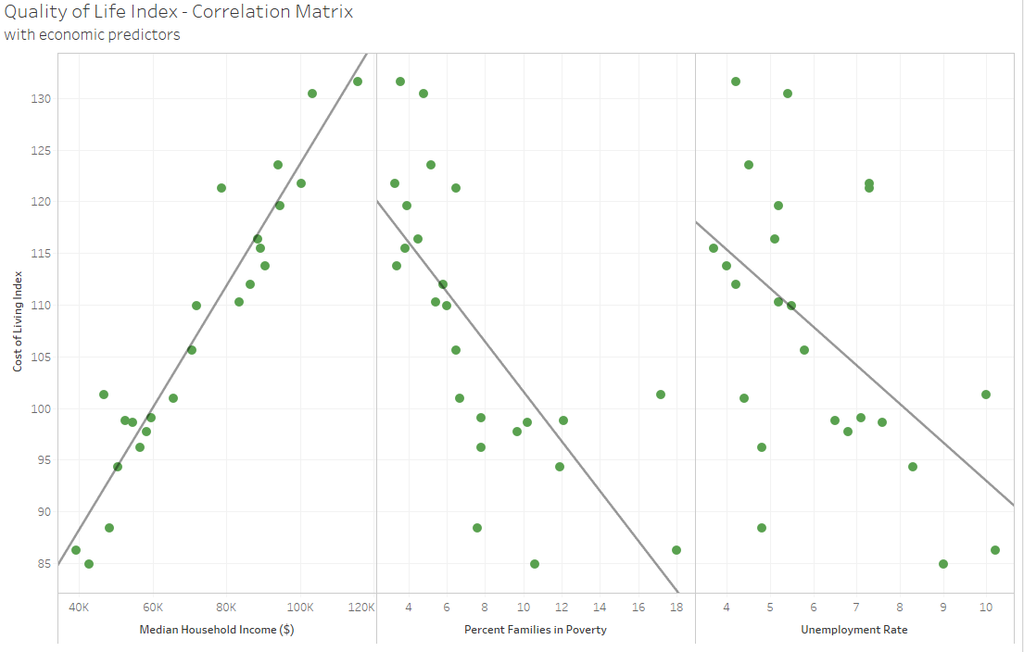
Notes:
As expected, the data points that specifically factor into a quality of life calculation had high statistical significance. This included Median household income, percent of families in poverty and unemployment. Cost of living increases as the median household decreases and the percentage of families in poverty and unemployment rate decreases. Exceptions are Baltimore City and Somerset County that they have a higher rate of families in poverty with relatively low Cost of Living Index.

Slide 15
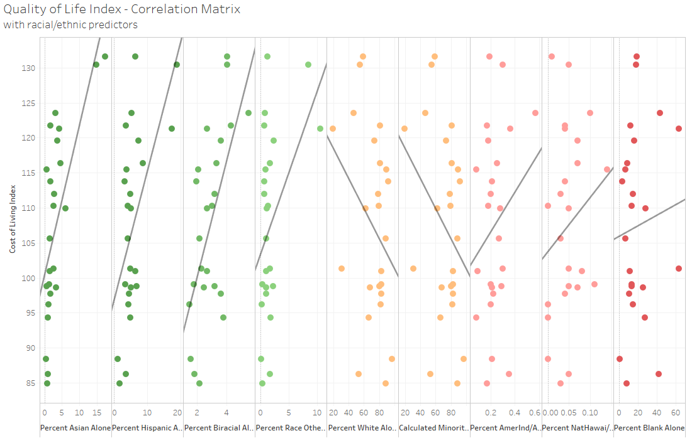
Notes:
Interestingly, race seemed to show up as moderately significant, though it may be more telling of that race’s predilection toward higher income levels. On the left, are populations that identified as Asian Alone, Hispanic/Latino (as an ethnicity, not race), Biracial, or other. Each of those showed a moderate to highly significant positive correlation.

Slide 16
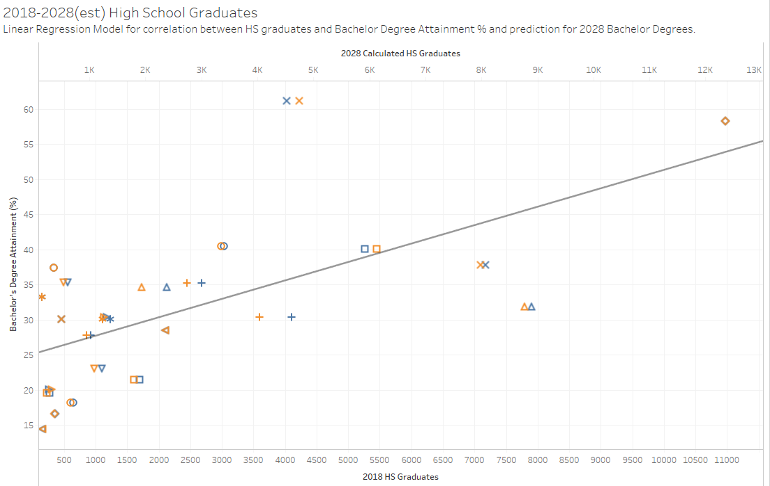
Notes:
This dual axis chart demonstrates the correlation between the Number of High School Graduates and Bachelor's Attainment percentage in 2018. In this case the correlation is statistically significant with a P-value of .0005. Estimated 2028 High School graduates is also plotted with the orange Marks. The reason for this is that if the linear model holds true, then we should be able to predict Bachelors degree attainment in the future given the predicted graduates for 2028. Another reason for plotting on the same graph is to see if the correlation line would still follow the same pattern and if there would not be too many outliers. In this case, there are no clear outliers.
Furthermore, we can see from the chart that by 2028, the high school graduates are predicted to grow by over 15% in Dorchester, Howard and Ann Arundel Counties; and at least 10% Montgomery, Charles, Worcester, Baltimore, Prince George’s, and Frederick Counties. It is notable that there are quite a few counties whose estimated high school graduates by 2028 is expected to decline by as much as 9% in Cecil, Baltimore City, Queen Anne’s, Carroll, and Garrett Counties. This relationship can be seen in the color-coded chart, in that orange marks for 2028, would be to the left of the blue if growth is expected.

Slide 17
What does this mean?
STAKEHOLDER ANALYSIS
17
Notes:
Discuss the implications of the findings to our specific stakeholders.
For people who are considering moving to Maryland, if the quality of life takes priority when choosing the county to settle in, Howard County, Montgomery County and Calvert County are good places to consider.
For state and county governments, the worst performing areas should be investigated. For example, Baltimore city and Somerset County. Compared to well performing counties, while their education expenditures are sufficient, their high school attainments are lower than other counties.
For NGO and advocates, they may be interested to look at those counties that receive least educational resources. They would launch campaigns and look for alternative ways to help areas to get educational resources as many as possible.
Further research would be recommended to tease out moderately correlated data where the r-squared is low. This indicates that the model does not explain the data well. Areas would include race as related to high school attainment, Cost of Living and Median Household income as it related to the Student-to-Teacher ratio, and Unemployment Rates and Racial Demographics as related to Quality of Life.

Slide 18
Hypotheses
...counties with better high school attainment also have a lower poverty rate, higher income, and/or more residents with college degrees.
...counties that spend more money on education will also report better educational outcomes.
...counties with a higher median income and/or quality of life score will spend more money on education.
...Montgomery county will be in the top 10% in terms of income, educational outcomes and
...Maryland will be in the top 25% of the country in terms of higher education degrees attained.
...regardless of educational spending, Black and Hispanic students will have a lower rate of graduation than their White or Asian counterparts.
Income = TRUE, HS Grad = FALSE,
TRUE
FALSE
TRUE
FALSE
FALSE
Notes:
Note: True/False shows up on click. Slide displays questions first, then each column’s true/false displays on separate clicks.

Slide 19

TAKEAWAYS
Top 5 Cost of Living – Howard, Montgomery, Charles, Calvert, Prince George’s
Top 5 performing HS – Howard, Calvert, Harford, Charles, and Frederick
Low 5 performing HS – Somerset, Caroline, Baltimore, Dorchester, and Prince George’s
HS Degree has significant impact on Quality of Life, Poverty, and Income.
Monetary investment does not necessarily lead to improved HS graduation rates.
Notes:
What are some key takeaways from our analysis?
Prince George’s was highlighted to show it as an outlier for HS attainment. High cost of living, how HS attainment percentage.
Education cannot be emphasized enough. To help improve a county’s quality of life, education should be the first thing to take care of.
To invest more in public schools does not necessarily lead to a better quality of life for a county.

Slide 20
Maryland County
Open Data
THANK YOU
Byng, Cao, Cruz, Fang, Juttukonda
Notes:
Image Attribution: iStock Retrieved from https://www.washingtonexaminer.com/opinion/op-eds/douglass-county-heres-how-dc-can-gain-congressional-representation-through-retrocession-to-maryland

